Slide 1
Relevance Feedback and Query expansion

Slide 2
Overview
Improving results
For high recall. E.g., searching for aircraft doesn’t match with plane; nor thermodynamic with heat
Options for improving results…
Global methods
Query expansion
Thesauri
Automatic thesaurus generation
Local methods
Relevance feedback
Pseudo relevance feedback
Notes:
The examples in the first bullet refer to the Cranfield data set which we have used as a programming exercise.

Slide 3
Relevance Feedback
Sec. 9.1
Relevance feedback: user feedback on relevance of docs in initial set of results
User issues a (short, simple) query
The user marks some results as relevant or non-relevant.
The system computes a better representation of the information need based on feedback.
Relevance feedback can go through one or more iterations.
Idea: it may be difficult to formulate a good query when you don’t know the collection well, so iterate

Slide 4
Relevance feedback
Sec. 9.1
We will use ad hoc retrieval to refer to regular retrieval without relevance feedback.
We now look at four examples of relevance feedback that highlight different aspects.

Slide 5

Similar pages

Slide 6
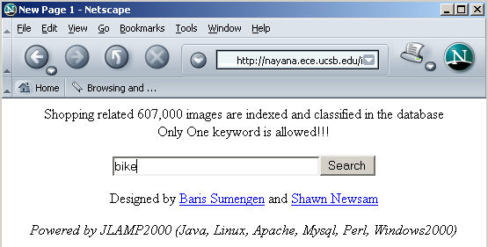
Relevance Feedback: Example
Sec. 9.1.1
Image search engine http://nayana.ece.ucsb.edu/imsearch/imsearch.html

Slide 7
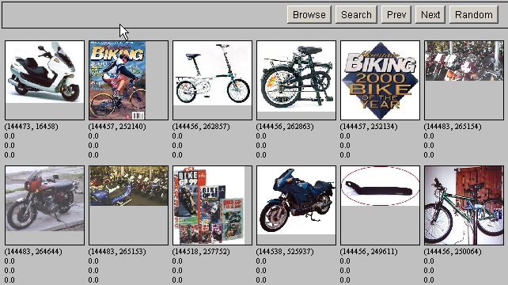
Results for Initial Query
Sec. 9.1.1

Slide 8
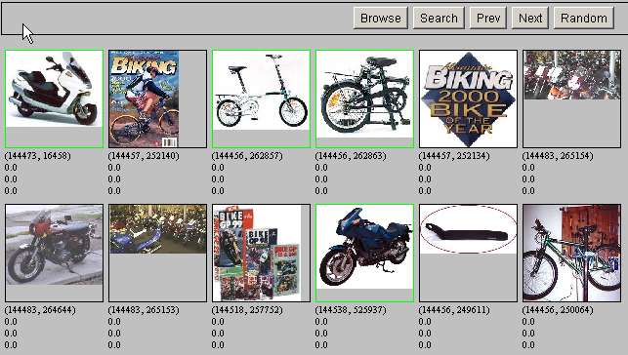
Relevance Feedback
Sec. 9.1.1

Slide 9
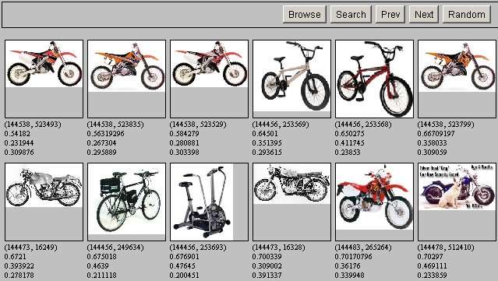
Results after Relevance Feedback
Sec. 9.1.1

Slide 10


Slide 11


Slide 12
Initial query/results
Sec. 9.1.1
Initial query: New space satellite applications
1. 0.539, 08/13/91, NASA Hasn’t Scrapped Imaging Spectrometer
2. 0.533, 07/09/91, NASA Scratches Environment Gear From Satellite Plan
3. 0.528, 04/04/90, Science Panel Backs NASA Satellite Plan, But Urges Launches of Smaller Probes
4. 0.526, 09/09/91, A NASA Satellite Project Accomplishes Incredible Feat: Staying Within Budget
5. 0.525, 07/24/90, Scientist Who Exposed Global Warming Proposes Satellites for Climate Research
6. 0.524, 08/22/90, Report Provides Support for the Critics Of Using Big Satellites to Study Climate
7. 0.516, 04/13/87, Arianespace Receives Satellite Launch Pact From Telesat Canada
8. 0.509, 12/02/87, Telecommunications Tale of Two Companies
User then marks relevant documents with “+”.
+
+
+

Slide 13
Expanded query after relevance feedback
Sec. 9.1.1
2.074 new 15.106 space
30.816 satellite 5.660 application
5.991 nasa 5.196 eos
4.196 launch 3.972 aster
3.516 instrument 3.446 arianespace
3.004 bundespost 2.806 ss
2.790 rocket 2.053 scientist
2.003 broadcast 1.172 earth
0.836 oil 0.646 measure

Slide 14
Results for expanded query
Sec. 9.1.1
2
1. 0.513, 07/09/91, NASA Scratches Environment Gear From Satellite Plan
2. 0.500, 08/13/91, NASA Hasn’t Scrapped Imaging Spectrometer
3. 0.493, 08/07/89, When the Pentagon Launches a Secret Satellite, Space Sleuths Do Some Spy Work of Their Own
4. 0.493, 07/31/89, NASA Uses ‘Warm’ Superconductors For Fast Circuit
5. 0.492, 12/02/87, Telecommunications Tale of Two Companies
6. 0.491, 07/09/91, Soviets May Adapt Parts of SS-20 Missile For Commercial Use
7. 0.490, 07/12/88, Gaping Gap: Pentagon Lags in Race To Match the Soviets In Rocket Launchers
8. 0.490, 06/14/90, Rescue of Satellite By Space Agency To Cost $90 Million
1
8

Slide 15
Key concept: Centroid
Sec. 9.1.1
The centroid is the center of mass of a set of points
Recall that we represent documents as points in a high-dimensional space
Definition: Centroid
where C is a set of documents.

Slide 16
Rocchio Algorithm
Sec. 9.1.1
The Rocchio algorithm uses the vector space model to pick a relevance feedback query
Rocchio seeks the query q_{opt} that maximizes
Tries to separate docs marked relevant and non-relevant
Problem: we don’t know the truly relevant docs

Slide 17
The Theoretically Best Query
Sec. 9.1.1
x
x
x
x
o
x
x
x
x
x
x
x
x
o
x
o
x
o
x
x
Δ
o
o
x
x
x non-relevant documents
o relevant documents
Optimal query

Slide 18
Rocchio 1971 Algorithm (SMART)
Sec. 9.1.1
Used in practice:
D_{r} = set of known relevant doc vectors
D_{nr} = set of known irrelevant doc vectors
Different from C_{r} and C_{nr}
q_{m} = modified query vector; q₀ = original query vector; α,β,γ: weights (hand-chosen or set empirically)
New query moves toward relevant documents and away from irrelevant documents
Notes:
SMART: Cornell (Salton) IR system of 1970s to 1990s.

Slide 19
Subtleties to note
Sec. 9.1.1
Tradeoff α vs. β/γ : If we have a lot of judged documents, we want a higher β than γ.
Some weights in query vector can go negative
Negative term weights are ignored (set to 0)

Slide 20
Relevance feedback on initial query
Sec. 9.1.1
Initial query
x
x
x
o
x
x
x
x
Δ
x
x
x
o
x
o
x
Δ
x
o
x
o
o
x
x
x
x
x known non-relevant documents
o known relevant documents
Revised query

Slide 21
Relevance Feedback in vector spaces
Sec. 9.1.1
We can modify the query based on relevance feedback and apply standard vector space model.
Use only the docs that were marked.
Relevance feedback can improve recall and precision
Relevance feedback is most useful for increasing recall in situations where recall is important
Users can be expected to review results and to take time to iterate
Notes:
Just as we modified the query in the vector space model, we can also modify it here. I’m not aware of work that uses language model based Ir this way.

Slide 22
Positive vs Negative Feedback
Sec. 9.1.1
Positive feedback is more valuable than negative feedback (so, set γ < β; e.g. γ = 0.25, β = 0.75).
Many systems only allow positive feedback (γ=0).
Why?
Notes:
It’s harder for user to give negative feedback (absence of evidence is not evidence of absence). It’s also harder to use since relevant documents can often form tight cluster, but non-relevant documents rarely do.

Slide 23
Example of Rocchio Algorithm
Original Query
Positive feedback
Negative feedback
0 | 4 | 0 | 8 | 0 | 0
2 | 4 | 8 | 0 | 0 | 2
8 | 0 | 4 | 4 | 0 | 16

Slide 24
Aside: Vector Space can be Counterintuitive.
Doc
“J. Snow
& Cholera”
x
x
x
x
x
x
o
x
x
x
x
x
x
x
q1
x
x
x
x
x
x
x
x
x
q1 query “cholera”
o www.ph.ucla.edu/epi/snow.html
x other documents
Query
“cholera”
Notes:
Snow document puts a lot of weird historical stuff into the vectory

Slide 25
High-dimensional Vector Spaces
The queries “cholera” and “john snow” are far from each other in vector space.
How can the document “John Snow and Cholera” be close to both of them?
Our intuitions for 2- and 3-dimensional space don't work in >10,000 dimensions.
3 dimensions: If a document is close to many queries, then some of these queries must be close to each other.
Doesn't hold for a high-dimensional space.
Notes:
Q = query, Cr = relevant documents Cnr = not relevant documents

Slide 26
Relevance Feedback: Assumptions
Sec. 9.1.3
A1: User has sufficient knowledge for initial query.
A2: Relevance prototypes are “well-behaved”.
Term distribution in relevant documents will be similar
Term distribution in non-relevant documents will be different from those in relevant documents
Either: All relevant documents are tightly clustered around a single prototype.
Or: There are different prototypes, but they have significant vocabulary overlap.
Similarities between relevant and irrelevant documents are small

Slide 27
Violation of A1
Sec. 9.1.3
User does not have sufficient initial knowledge.
Examples:
Misspellings.
Cross-language information retrieval.
Mismatch of searcher’s vocabulary vs. collection vocabulary
Cosmonaut/astronaut

Slide 28
Violation of A2
Sec. 9.1.3
There are several relevance prototypes.
Examples:
Burma/Myanmar
Contradictory government policies
Pop stars that worked at Burger King
Often: instances of a general concept
Good editorial content can address problem
Report on contradictory government policies

Slide 29
Relevance Feedback: Problems
Long queries are inefficient for typical IR engine.
Long response times for user.
High cost for retrieval system.
Partial solution:
Only reweight certain prominent terms
Perhaps top 20 by term frequency
Users are often reluctant to provide explicit feedback
It’s often harder to understand why a particular document was retrieved after applying relevance feedback
Why?
Notes:
A long vector space query is like a disjunction: you have to consider documents with any of the words, and sum partial cosine similarities over the various terms.

Slide 30
Evaluation of relevance feedback strategies
Sec. 9.1.5
Use q₀ and compute precision and recall graph
Use q_{m} and compute precision recall graph
Assess on all documents in the collection
Spectacular improvements, but … it’s cheating!
Partly due to known relevant documents ranked higher
Must evaluate with respect to documents not seen by user
Use documents in residual collection (set of documents minus those assessed relevant)
Measures usually then lower than for original query
But a more realistic evaluation
Relative performance can be validly compared
Empirically, one round of relevance feedback is often very useful. Two rounds is sometimes marginally useful.
Notes:
It’s lower because the results aren’t on the documents that came in top on the original query, which are the ones most likely to be relevant.

Slide 31
Evaluation of relevance feedback
Sec. 9.1.5
Second method – assess only the docs not rated by the user in the first round
Could make relevance feedback look worse than it really is
Can still assess relative performance of algorithms
Most satisfactory – use two collections each with their own relevance assessments
q₀ and user feedback from first collection
q_{m} run on second collection and measured

Slide 32
Evaluation: Caveat
Sec. 9.1.3
True evaluation of usefulness must compare to other methods taking the same amount of time.
Alternative to relevance feedback: User revises and resubmits query.
Users may prefer revision/resubmission to having to judge relevance of documents.
There is no clear evidence that relevance feedback is the “best use” of the user’s time.

Slide 33
Relevance Feedback on the Web
Sec. 9.1.4
Some search engines offer a similar/related pages feature (this is a trivial form of relevance feedback)
Google (link-based)
Altavista
Stanford WebBase
But some don’t because it’s hard to explain to average user:
Alltheweb
bing
Yahoo
Excite initially had true relevance feedback, but abandoned it due to lack of use.

Slide 34
Excite Relevance Feedback
Sec. 9.1.4
Spink et al. 2000
Only about 4% of query sessions from a user used relevance feedback option
Expressed as “More like this” link next to each result
But about 70% of users only looked at first page of results and didn’t pursue things further
So 4% is about 1/8 of people extending search
Relevance feedback improved results about 2/3 of the time

Slide 35
Pseudo relevance feedback
Sec. 9.1.6
Pseudo-relevance feedback automates the “manual” part of true relevance feedback.
Pseudo-relevance algorithm:
Retrieve a ranked list of hits for the user’s query
Assume that the top k documents are relevant.
Do relevance feedback (e.g., Rocchio)
Works very well on average
But can go horribly wrong for some queries.
Several iterations can cause query drift.
Why?

Slide 36
Query Expansion
Sec. 9.2.2
In relevance feedback, users give additional input (relevant/non-relevant) on documents, which is used to reweight terms in the documents
In query expansion, users give additional input (good/bad search term) on words or phrases

Slide 37

Query assist
Would you expect such a feature to increase the query
volume at a search engine?

Slide 38
How do we augment the user query?
Sec. 9.2.2
Manual thesaurus
E.g. MedLine: physician, syn: doc, doctor, MD, medico
Can be query rather than just synonyms
Global Analysis: (static; of all documents in collection)
Automatically derived thesaurus
(co-occurrence statistics)
Refinements based on query log mining
Common on the web
Local Analysis: (dynamic)
Analysis of documents in result set

Slide 39
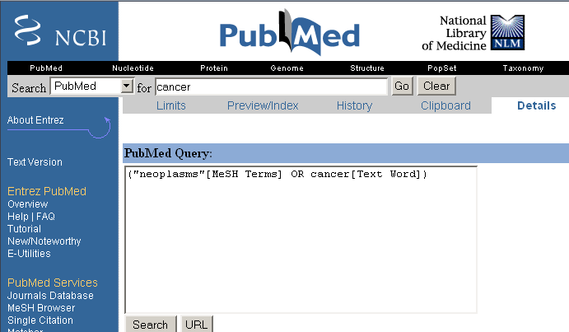
Example of manual thesaurus
Sec. 9.2.2

Slide 40
Thesaurus-based query expansion
Sec. 9.2.2
For each term, t, in a query, expand the query with synonyms and related words of t from the thesaurus
feline → feline cat
May weight added terms less than original query terms.
Generally increases recall
Widely used in many science/engineering fields
May significantly decrease precision, particularly with ambiguous terms.
“interest rate” → “interest rate fascinate evaluate”
There is a high cost of manually producing a thesaurus
And for updating it for scientific changes

Slide 41
Automatic Thesaurus Generation
Sec. 9.2.3
Attempt to generate a thesaurus automatically by analyzing the collection of documents
Fundamental notion: similarity between two words
Definition 1: Two words are similar if they co-occur with similar words.
Definition 2: Two words are similar if they occur in a given grammatical relation with the same words.
You can harvest, peel, eat, prepare, etc. apples and pears, so apples and pears must be similar.
Co-occurrence based is more robust, grammatical relations are more accurate.

Slide 42
Co-occurrence Thesaurus
Sec. 9.2.3
Simplest way to compute one is based on term-term similarities in C = AA^{T} where A is term-document matrix.
w_{i,j} = (normalized) weight for (t_{i} ,d_{j})
For each t_{i}, pick terms with high values in C
d_{j}
N
What does C contain if A is a term-doc incidence (0/1) matrix?
t_{i}
M

Slide 43
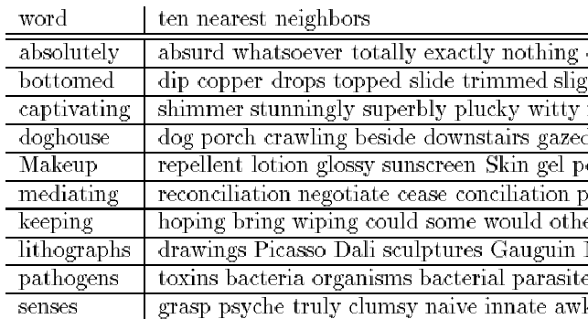
Automatic Thesaurus Generation Example
Sec. 9.2.3

Slide 44
Automatic Thesaurus Generation Discussion
Sec. 9.2.3
Quality of associations is usually a problem.
Term ambiguity may introduce irrelevant statistically correlated terms.
“Apple computer” → “Apple red fruit computer”
Problems:
False positives: Words deemed similar that are not
False negatives: Words deemed dissimilar that are similar
Since terms are highly correlated anyway, expansion may not retrieve many additional documents.

Slide 45
Indirect relevance feedback
On the web, DirectHit introduced a form of indirect relevance feedback.
DirectHit ranked documents higher that users look at more often.
Clicked on links are assumed likely to be relevant
Assuming the displayed summaries are good, etc.
Globally: Not necessarily user or query specific.
This is the general area of clickstream mining
Today – handled as part of machine-learned ranking
Notes:
Link analysis is kind of similar too.

